Slide 1


Final Analysis:
Profit Dashboard and Sheets for Sprocket Central
By: Jainam Shah, Junior Consultant, KPMG Data Analytics Team

Slide 2
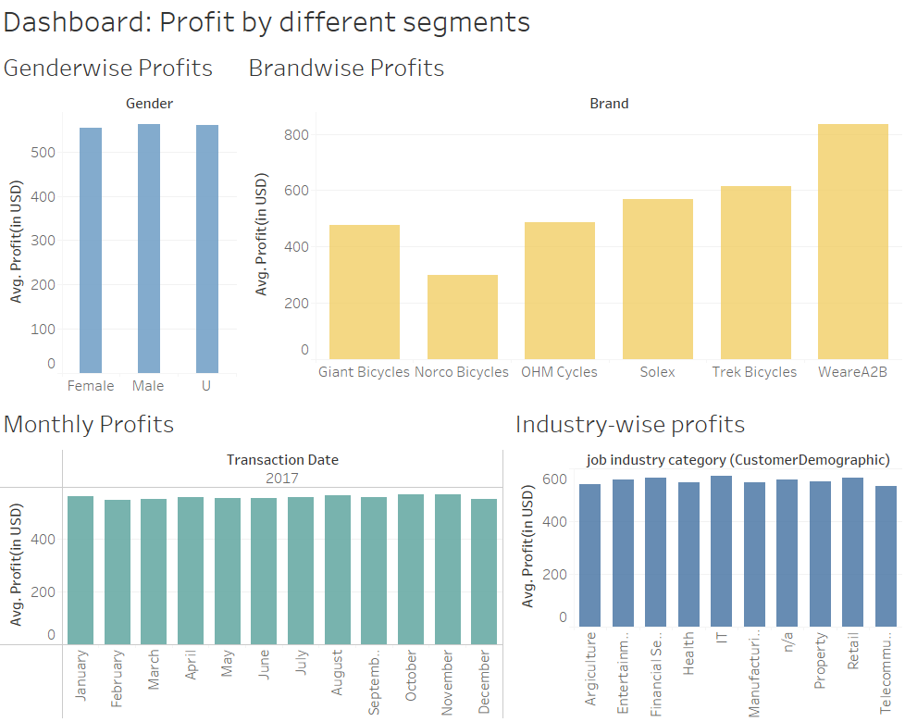
Dashboard. We have explained each graph in next slides.

Slide 3
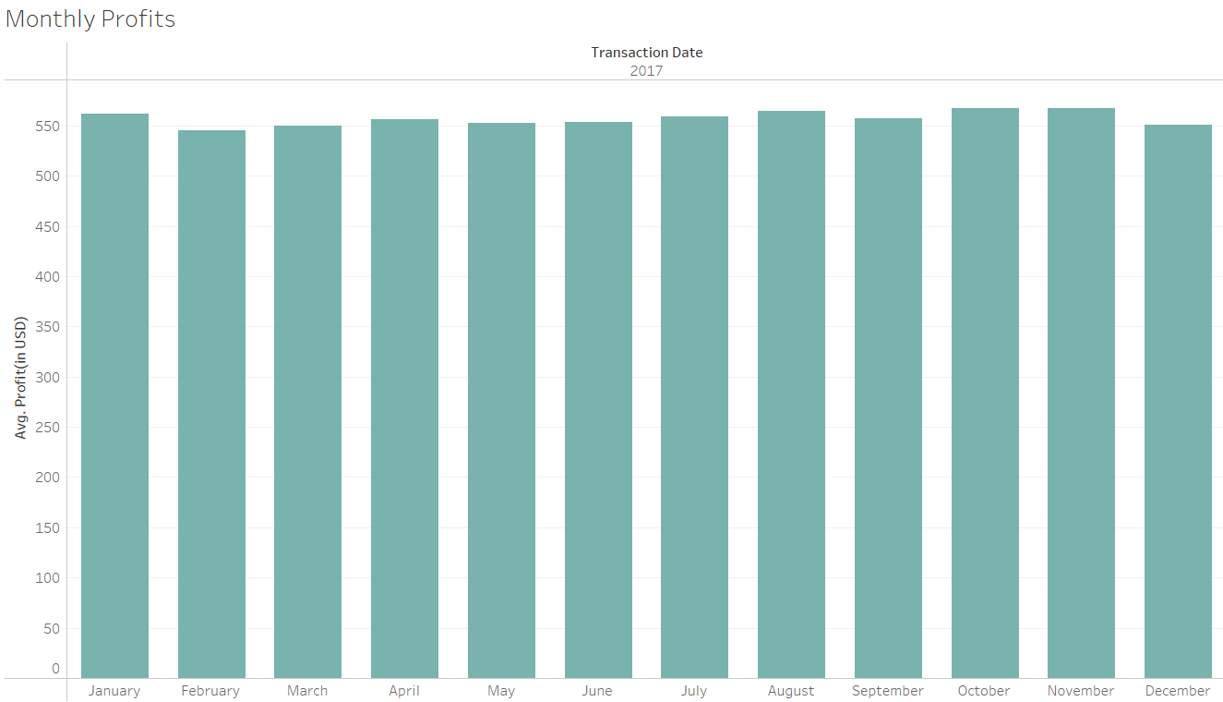
Average profits by Month for year 2017

Slide 4
What does the monthly profits says?
Average Profit is marked above $500 every month with highest average profit of $567.47 in November.
Top month for profit are:
November ($567.47)
October($567.12)
August($564.15)
3. Quarter-wise Average Profit Analysis:
Q1(Jan-Apr) : $2213.68
Q2(May-Aug): $2229.23
Q3(Sept-Dec): $2242.53
As we can see the best profits are shown in Q3 followed by Q2 & Q1.

Slide 5
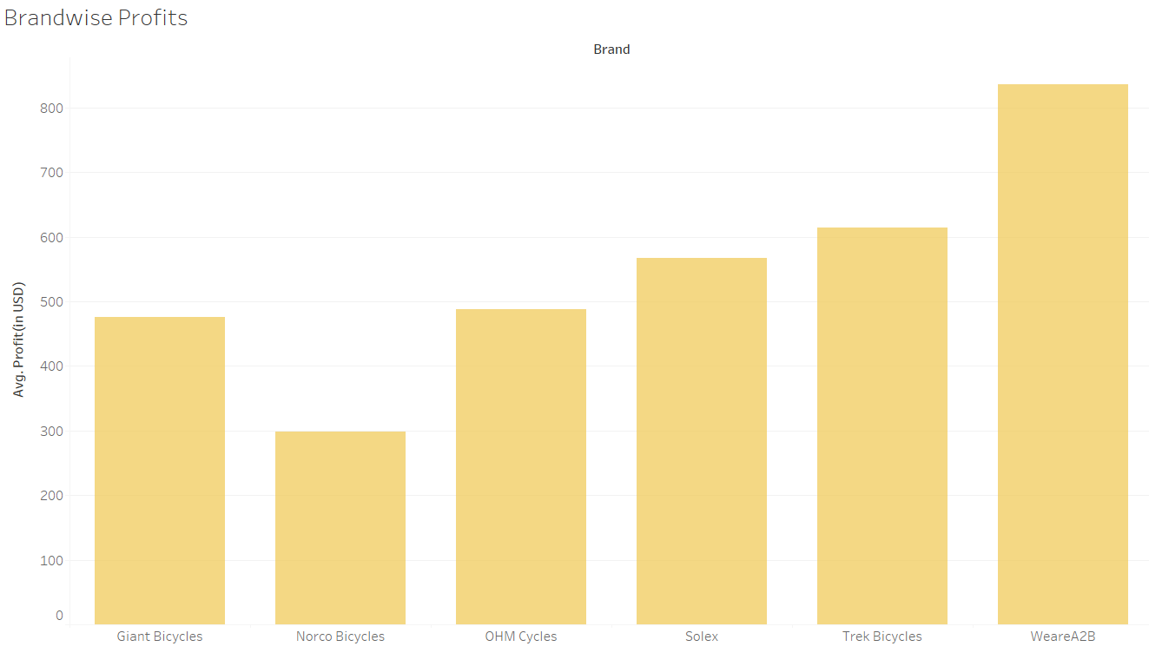
Profits by Brand

Slide 6
Brand wise Profits:
As we can see, WeareA2B has highest average profit of $835.78.
Brands with Highest to lowest average profit.
WeareA2B: $835.78
Trek Bicycles: $614.71
Solex: $567.56
OHM Cycles: $487.36
Giant Bicycles: $475.19
Norco Bicycles: $298.17
3. We should focus more on Increasing profit of Norco and Giant Bicycles.

Slide 7
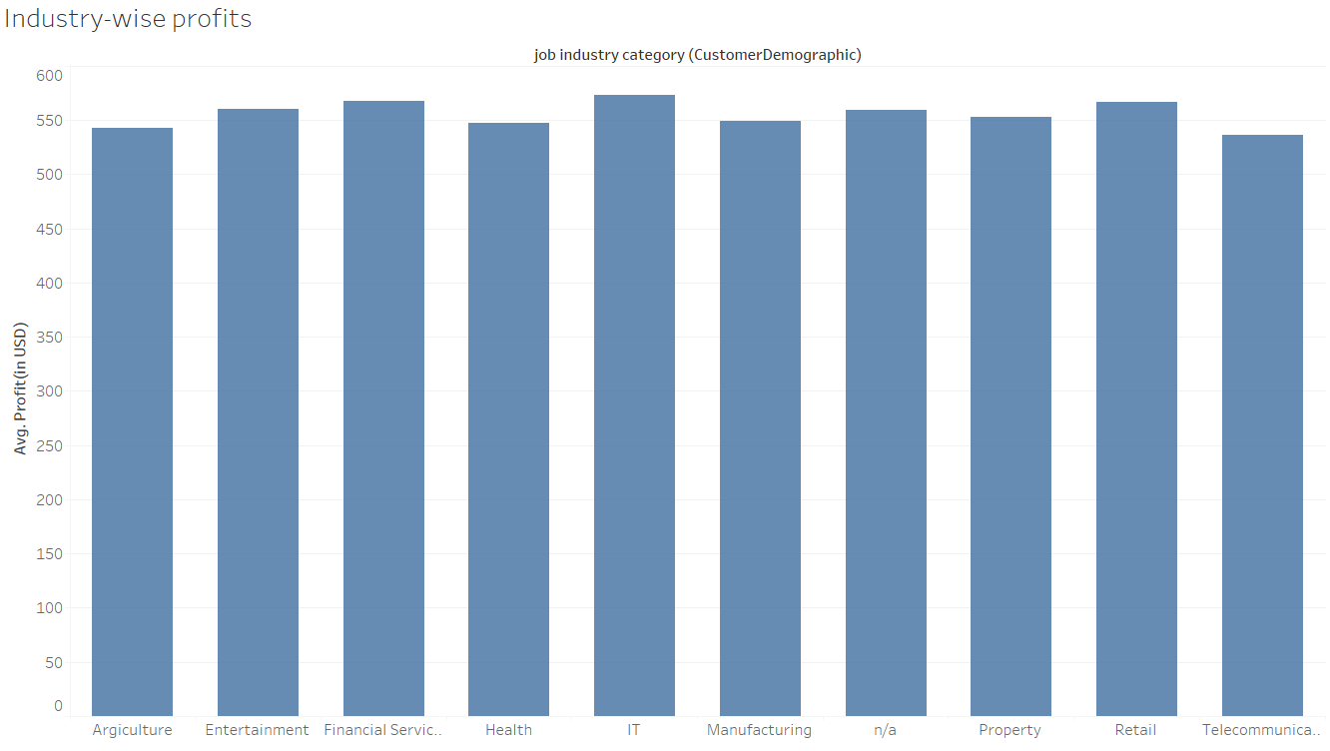
What industry our highest profit customers work in:

Slide 8
Industry wise Profits:
Customers having IT background brings highest average profit of $573.08.
Top Industries:
IT: $573.08
Financial Services: $567.29
Retail: $567.09
3. Telecommunications, Agriculture and Health backgrounds have least profit generation of $536.44, $542.91and $547.57 respectively.

Slide 9
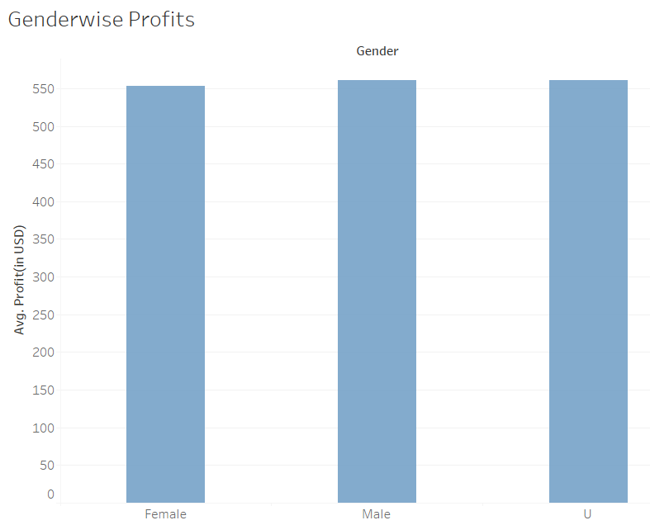
Gender wise distributions of Average Profit
Male: $561.29
Female: $553.32
Undisclosed: $560.56

Slide 10
What additional external datasets may be useful to obtain greater insights into customer preferences:
If the datasets of Revenue generated was provided, we can get the insights of revenue vs profit, so we can get an in-depth perspective of Revenue, Costs and Profits.
Marketing Strategy:
Since we’re trying to Increase profits form under-performing factors, our marketing strategy should look like this:
An advertisement of a female farmer(due to less profit generated by Agricultural background and females), buying Giant or Norco bicycles(less profit generating bicycles) for her kid/s. and we should target that particular audience for that.
For the highest performing factors, we need not to invest too much into marketing, but strategy should be like this:
A Financial officer of an IT company in their 50s (due to IT and financial services industries customers bring the highest average profit and most customers are in their 50s), buys WeareA2B cycles for their kid/s.

Slide 11
Thank you
Jainam Shah, Junior consultant, KPMG Data Analytics Team.

